Slide 1



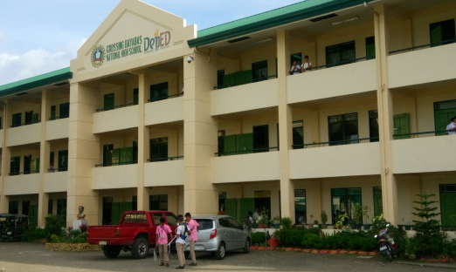
HiSRMS v2.0 Manual
General User Guide for Dummies

Slide 2
Table of Contents

Slide 3
General Terms
Module/System/Application – refers to the a program/software installed.
Access Level – refers to a user’s access to a certain program. Access to certain features are restricted to lower levels, while higher levels have less-to-no feature restrictions.
Administrator (Access Level 5) – has full control of the entire system without any restrictions. It is recommended that the School’s IT Personnel should only have administrator accounts for troubleshooting bugs.
Registrar (Access Level 4) – has full control of the entire system with minimal restrictions on each module. The School’s Registry personnel are the recommended users since
Curriculum Head (Access Level 3) – has access to Registration System only. He/She is responsible for managing subjects, curriculums and managing Department Head users.
Department Head (Access Level 2) – has access to Grading System only. He/She is responsible for approving grades submitted by advisers during grading period before the Registrar closes the submission.

Slide 4


HiSRMS Launcher
01
Opens and manages the modules used by the entire system. It also manages the variables used for processing the records inside other modules.

Slide 5
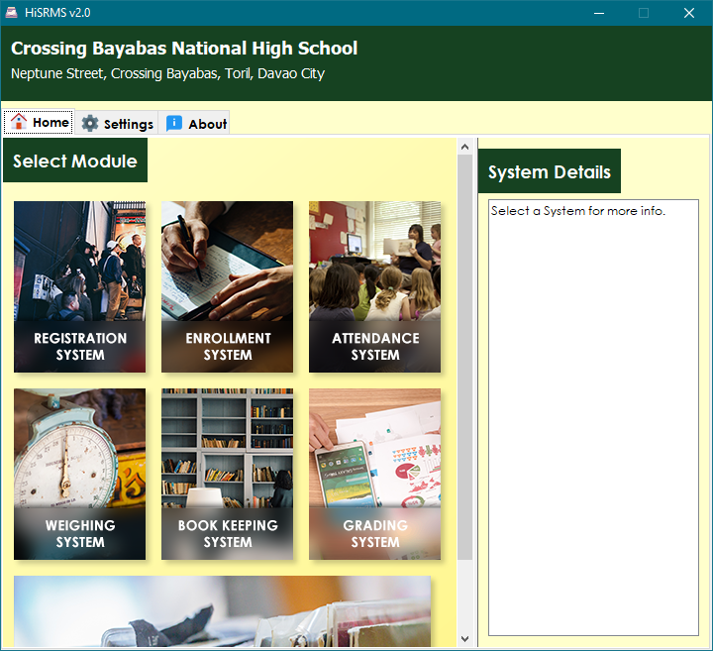
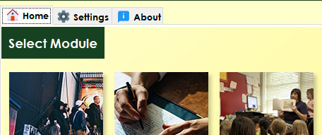
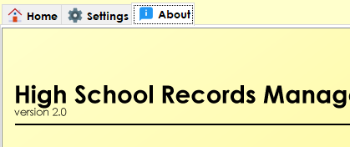

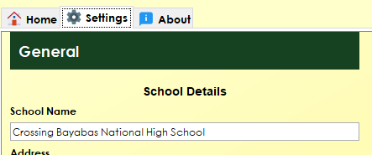
The General User Interface
1. Home Tab
3. About Tab
Contains all the applications/modules installed on the system (7 in total).
Shows detailed information about the software.
2. Settings Tab
Note
Running a module will minimize this window.
Only one instance can only be opened per module. (ex. You can’t open two Registration windows at the same time)
On the Settings Tab, under Performance category, the IP Address field shall be provided by the IT personnel of the school.
Contains modifiable variables that will be used by the other applications when processing data.

Slide 6


Registration System
02
Stores the list of students, teachers, and subjects of the entire school. At the beginning of a school year, this application should be the first one used to register new incoming students and staff.

Slide 7
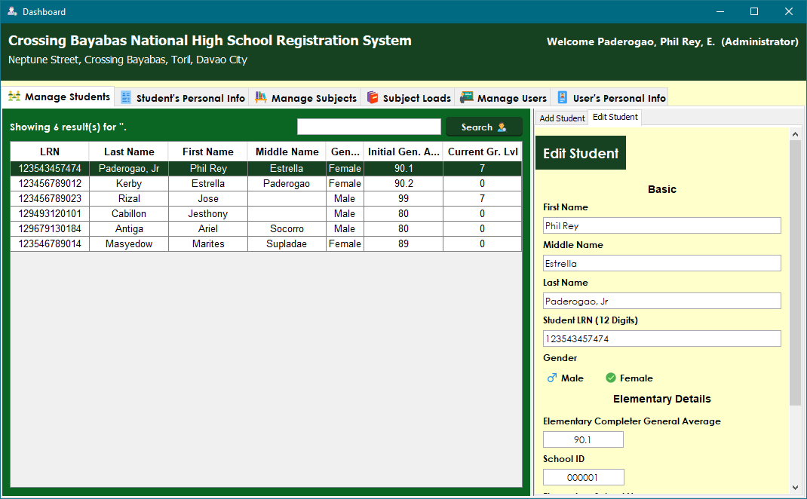
The User Interface

Slide 8


Note
Caution
Yeey
Yeey
Warning
Yeey

